Slide 1

GRAPHS
Table of Contents:
Graph Terminology
Representation of Graphs in Memory
Traversals in a Graph (DFS and BFS)

Slide 2
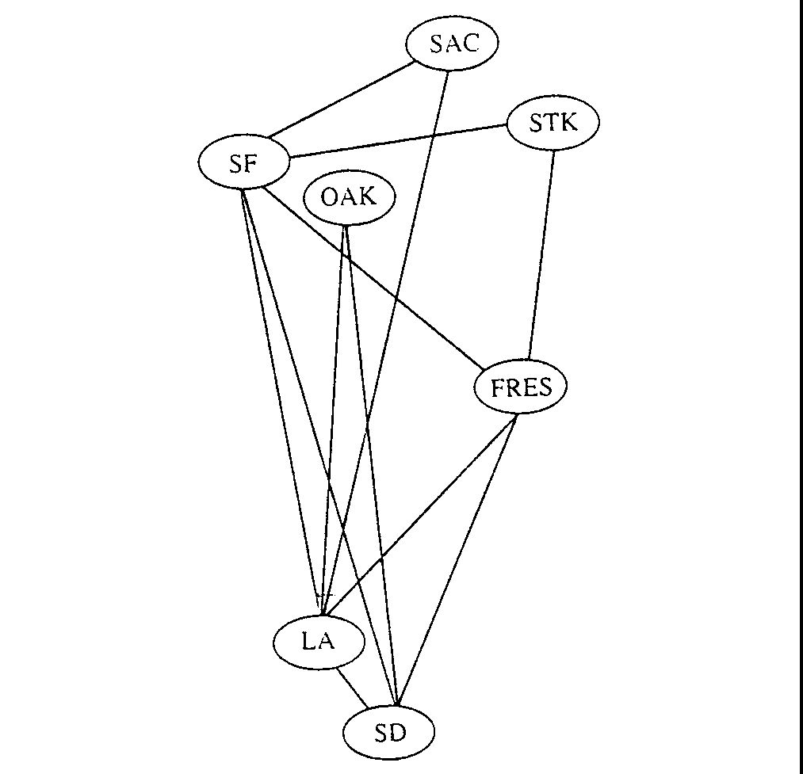
Problems: e.g. Airline Routes

Slide 3
GRAPH
A Graph G consists of
- a set V of elements called nodes ( points or vertices )
- a set E of edges such that each e in E is identified with unique unordered pair [u , v] of nodes in v and is denoted by e = [u , v]
G = ( V , E )
If e = [ u , v ] then
end points of e : u , v
Adjacent nodes or neighbor nodes : u , v
degree of a node : number of edges in node
isolated node : if deg(u) = 0

Slide 4
Path : path p of length n from node u to node v is a sequence of n+1 nodes.
( v₀, v₁, v₂, . . . . . , v_{n}) such that u = v₀ and v = v_{n}
v_{i-1} is adjacent to v_{i} for I = 1 to n
Closed Path : if v₀ ₌ v_{n}
Simple Path : If all nodes in a path are distinct
Cycle : closed path with length 3 or more

Slide 5
K - Cycle : cycle of length k
Connected Graph : If there is a path between any two of its node
Complete graph : If every node u in G is adjacent to every other node v in G. A complete graph will have n (n-1) /2 edges
Tree graph of free tree : Connected Graph without cycle
Labeled graphs : if edges are assigned data
Weights : non negative numeric value, may be Length of the edge. If no weight is specified then w(e) = 1 is considered
Weight of the Path : Sum of weights of all edges in this path
Multiple Edges : e1 and e2 are multiple edges if both e1 and e2 = [u , v]
Loops : is it has identical end points, e = [ u , u]

Slide 6
Directed Graph or Digraph : if edges have direction edge is identified by ordered pair of nodes ( u , v )
Arc : Directed Edge
Outdegree of node u : number of edges beginning at u
Indegree of node u : number of edges ending at u
Source node: +ve outdegree and 0 indegree
Sink : +ve indegree and 0 outdegree
A node v is reachable from node u if there is a directed path from v to u
Strongly connected directed graph : if for each pair of node there is a path from u to v and v to u
Unilaterally connected directed graph : if for each pair of node there is a path from u to v or v to u

Slide 7
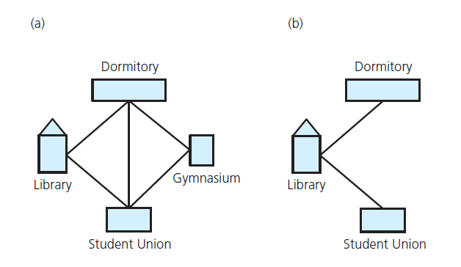
Graph Terminology
FIGURE : (a) A campus map as a graph (b) a subgraph

Slide 8
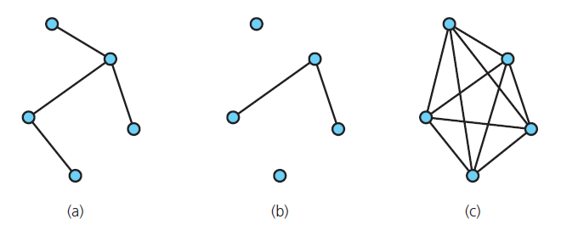
Terminology
FIGURE : Graphs that are (a) connected (b) disconnected and (c) complete

Slide 9
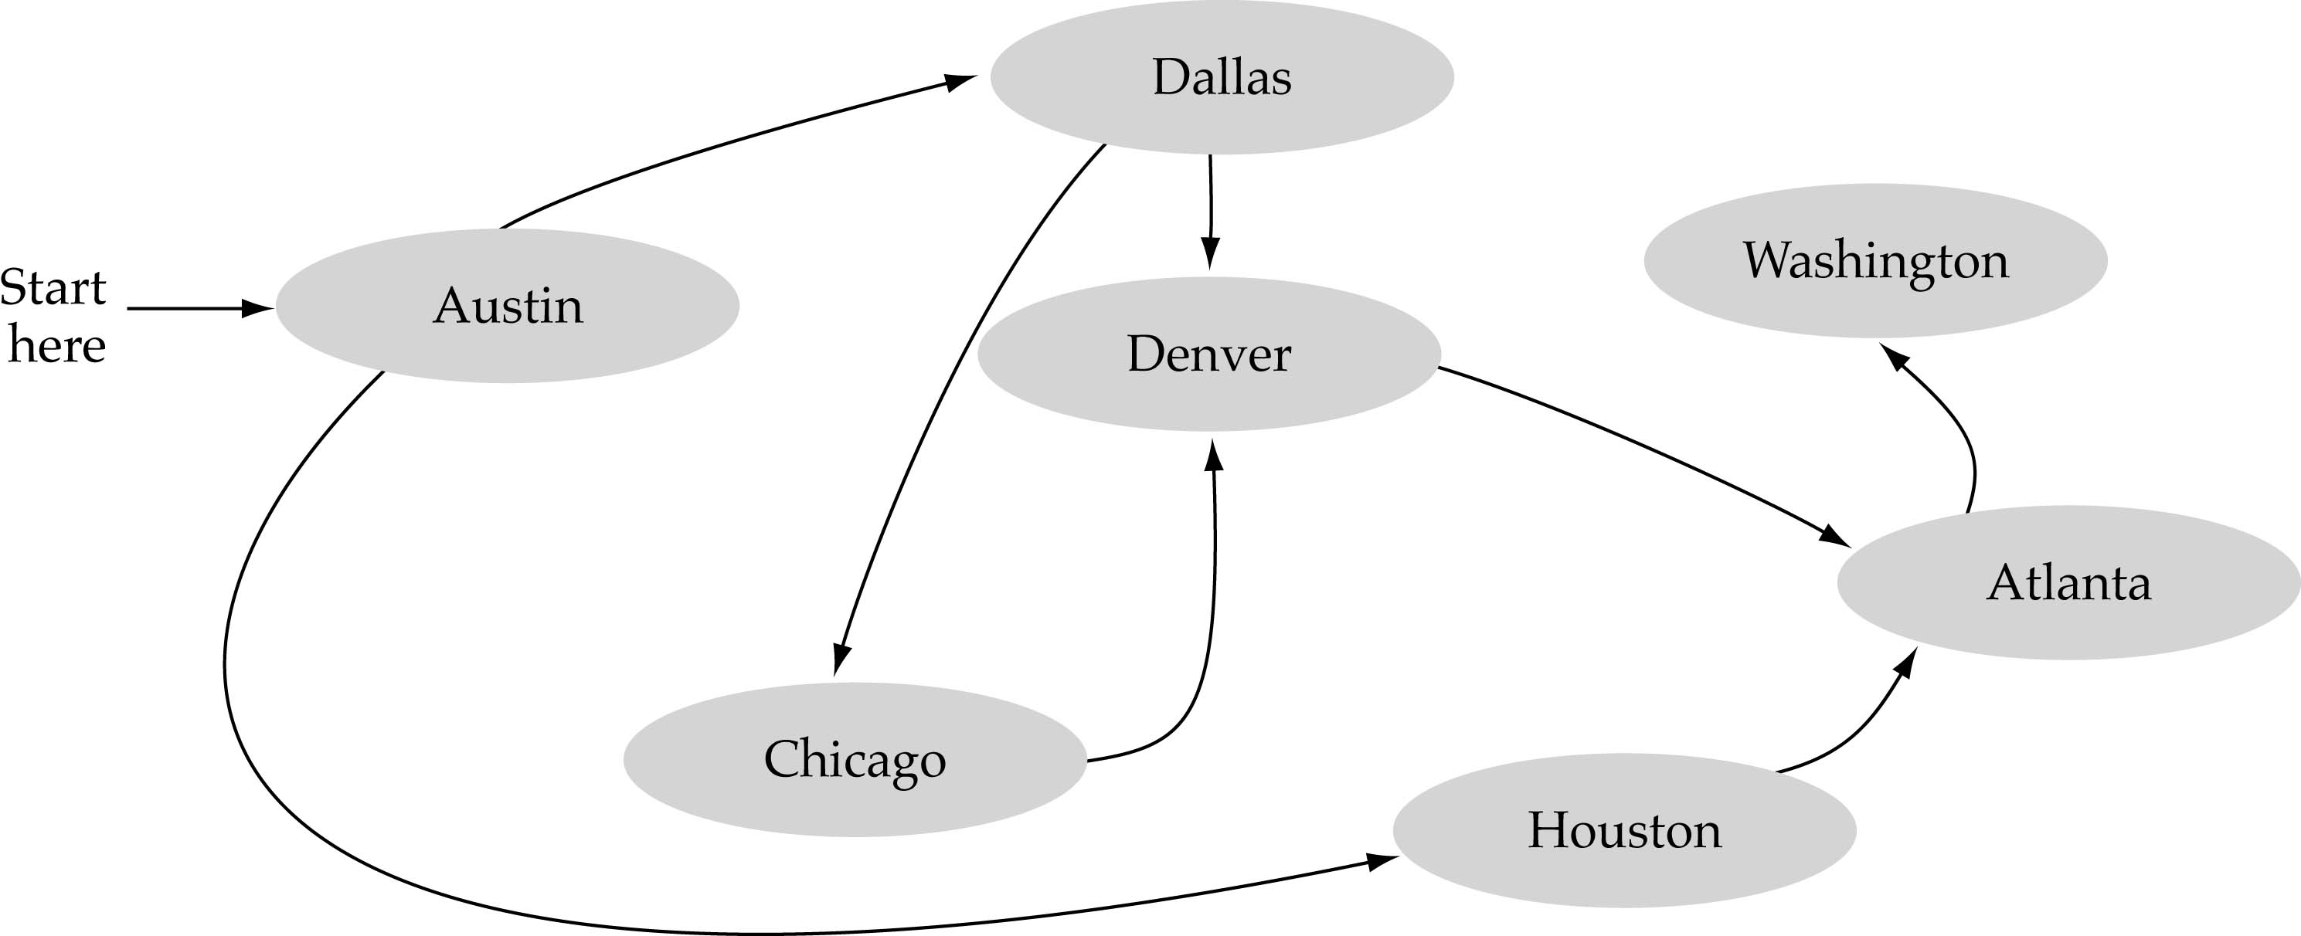
Directed Graph or Digraph : if edges have direction edge is identified by ordered pair of nodes ( u , v )
Outdegree of node u : number of edges beginning at u
Indegree of node u : number of edges ending at u
Source node: +ve outdegree and 0 indegree
Sink : +ve indegree and 0 outdegree

Slide 10
A complete graph with n nodes will have
n(n-1) /2 edges.

Slide 11
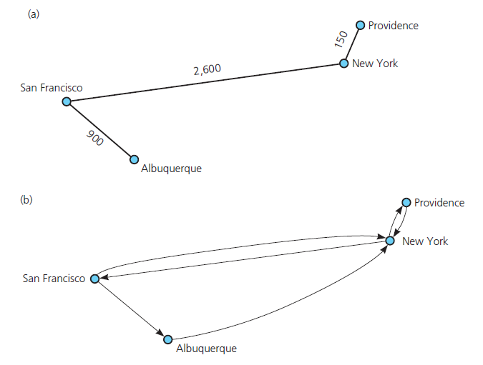
Terminology
FIGURE : (a) A weighted graph (b) a directed graph

Slide 12
Representation of Graphs
- Sequential Representation
- Linked Representation

Slide 13
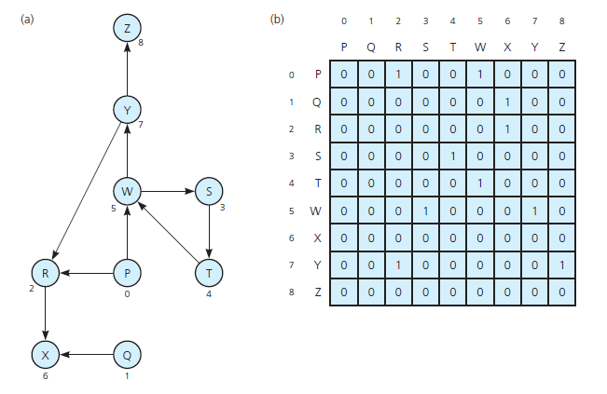
Implementing Graphs :Sequential Representation
Adjacency Matrix
FIGURE: (a) A directed graph (b) its adjacency matrix

Slide 14
Y
X
Z
W

Slide 15
Path Matrix
Y
X
Z
W
 | X | Y | Z | W
X | 0 | 0 | 0 | 1
Y | 1 | 0 | 1 | 1
Z | 1 | 0 | 0 | 1
W | 0 | 0 | 1 | 0
 | X | Y | Z | W
X | 0 | 0 | 1 | 0
Y | 1 | 0 | 1 | 2
Z | 0 | 0 | 1 | 1
W | 1 | 0 | 0 | 1
 | X | Y | Z | W
X | 1 | 0 | 0 | 1
Y | 1 | 0 | 2 | 2
Z | 1 | 0 | 1 | 1
W | 0 | 0 | 1 | 1
 | X | Y | Z | W
X | 0 | 0 | 1 | 1
Y | 2 | 0 | 2 | 3
Z | 1 | 0 | 1 | 2
W | 1 | 0 | 1 | 1
A₁ =
A₂ =
A₃ =
A₄ =
Number of Paths between Y to W of length 3 are 2
(Y -> Z -> X -> W AND Y->W->Z->W)
(yxwzw, yzwzw, ywzxw)
B₄ = A₁ + A₂ + A₃ + A₄
ij entry of matrix B₄ gives the number of paths of length 4 or less from node v_{i} to v_{j}
ij entry of matrix B_{r} gives the number of paths of length r or less from node v_{i} to v_{j}

Slide 16
 | X | Y | Z | W
X | 1 | 0 | 2 | 3
Y | 5 | 0 | 6 | 8
Z | 3 | 0 | 3 | 5
W | 2 | 0 | 3 | 3
 | X | Y | Z | W
X | 1 | 0 | 1 | 1
Y | 1 | 0 | 1 | 1
Z | 1 | 0 | 1 | 1
W | 1 | 0 | 1 | 1
B₄ =
P =
Let G be a simple directed graph with m nodes, v₁, v₂, v₃,. . . , v_{m}. The path matrix or reach ability matrix of G is m-square matrix P=(p _{ij} ) defined as follows:-
p _{ij} = 1 if path exist else 0

Slide 17
Quick Solutions
This yields an O(n³) algorithm on graphs with n vertices (on dense graphs and with a simple implementation).
Let P_{k} [i,j] denote ij entry of matrix P_{k}.
P_{k} [i,j]=1{If there is a simple path from v_{i} to v_{j} which does not use any other node except possibly v₁, v₂, . . . V_{k} }
=0 {otherwise}

Slide 18
Warshall’s Algorithm
A directed graph G with m nodes is maintained in memory by its adjacency matrix A. This algorithm finds the path matrix P of graph G.
Step 1. Repeat for I,J=1,2,. . . . M [Initializes P]
If A[I,J]=0, then set P[I,J]:=0;
Else P[I,J]:=1;
[End of Loop]
Step 2. Repeat steps 3 and 4 for K=1,2,. . . . M [Updates P.]
Step 3. Repeat step 4 for I=1,2,. . . . M [Updates P.]
Step 4. Repeat for J=1,2,. . . . M [Updates P.]
set P[I,J]:= P[I,J] v (P[I,K] ^ P[K,J]).
[End of Loop]
[End of step 3 Loop]
[End of step 2 Loop]
Step 5. Exit

Slide 19

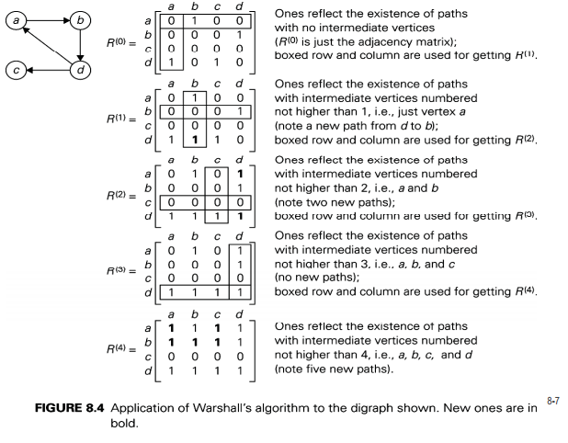
Example:

Slide 21
All-Pairs Shortest Path Problem
Suppose we are given a directed graph G=(V,E) and a weight function w: E->R.
We assume that G does not contain cycles of weight 0 or less.
The All-Pairs Shortest Path Problem asks to find the length of the shortest path between any pair of vertices in G.

Slide 22
W(i,j) = 0 if there is no edge between i and j.
W(i,j) = w(e) weight of edge”
q_{ij}=length of shortest path from vertex v_{i} to v_{j}.
Q_{k} [i,j]=the smaller of the length of the preceding path from v_{i} to v_{j} or the sum of the lengths of the preceding paths from v_{i} to v_{k} and v_{k} to v_{j}.
Q[I,J]:= min(Q[I,J], (Q[I,K] + Q[K,J]).
Q_{0 is} same as weight matrix W except that each 0 in W is replaced by infinity. The final matrix Q_{m} will be desired matrix Q.

Slide 23

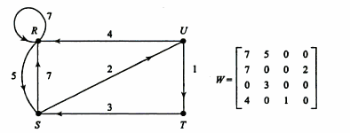
All pair shortest path Warshal’s Algorithm
A directed graph G with m nodes is maintained in memory by its weight matrix W. This algorithm finds the path matrix Q of graph G such that q[I,J] is length of shortest path from node u to v. INFINITY is very large number, and MIN is minimum value function.
Step 1. Repeat for I,J=1,2,. . . . M [Initializes P]
If W[I,J]=0, then set Q[I,J]:=INFINITY;
Else Q[I,J]:=W[I,J];
[End of Loop]
Step 2. Repeat steps 3 and 4 for K=1,2,. . . . M [Updates P.]
Step 3. Repeat step 4 for I=1,2,. . . . M [Updates P.]
Step 4. Repeat for J=1,2,. . . . M [Updates P.]
set Q[I,J]:= min(Q[I,J], (Q[I,K] + Q[K,J]).
[End of Loop]
[End of step 3 Loop]
[End of step 2 Loop]
Step 5. Exit

Slide 24
Solved problem All pair shortest path

Slide 25
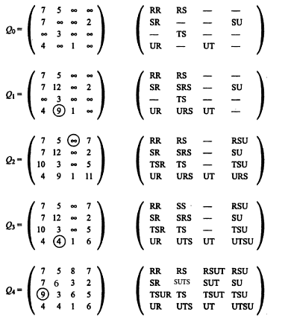
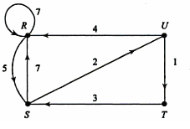


Slide 26
K=2 , S as intermediate, Q2
R S T U
R 7 5 INF 7
S 7 12 INF 2
T 10 3 INF 5
U 4 9 1 11
K=1 ie R as intermediate, Q1
R S T U
R 7 5 INF INF
S 7 12 INF 2
T INF 3 INF INF
U 4 9 1 INF
K=3, T as intermediate,Q3
K=4, U as intermediate, Q4
R S T U
R 7 5 INF 7
S 7 12 INF 2
T 10 3 INF 5
U 4 4 1 6
R S T U
R 7 5 8 7
S 6 6 3 2
T 9 3 6 5
U 4 4 1 6

Slide 27
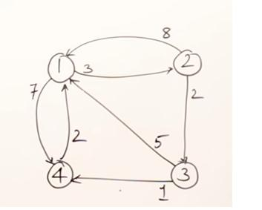
Find All pair shortest path

Slide 28
For K=1
1 2 3 4
1 INF 3 INF 7
2 8 11 2 15
3 5 8 INF 1
4 2 5 INF 9
K=2
1 2 3 4
1 11 3 5 7
2 8 11 2 15
3 5 8 10 1
4 2 5 7 9
K=3
1 2 3 4
1 10 3 5 6
2 7 10 2 3
3 5 8 10 1
4 2 5 7 8
K=4,
1 2 3 4
1 8 3 5 6
2 5 8 2 3
3 3 6 8 1
4 2 5 7 8

Slide 29
Linked Representation
Node List contains NODE, NEXT and ADJ
Edge list contains DEST and LINK
GRAPH is represented as:
GRAPH(NODE, NEXT,ADJ,START,AVAILN, DEST, LINK , AVAIL E)

Slide 30
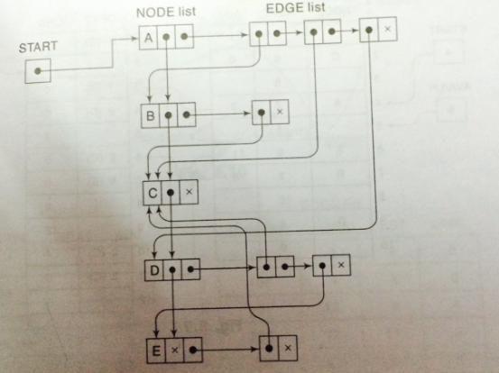
D
A
E
B
C
Node | Adjacency List
A | B, C, D
B | C
C
D | C, E
E | C
Node List contains NODE, NEXT and ADJ
Edge list contains DEST and LINK
GRAPH is represented as:
GRAPH(NODE, NEXT,ADJ,START,AVAILN, DEST, LINK , AVAIL E)

Slide 31
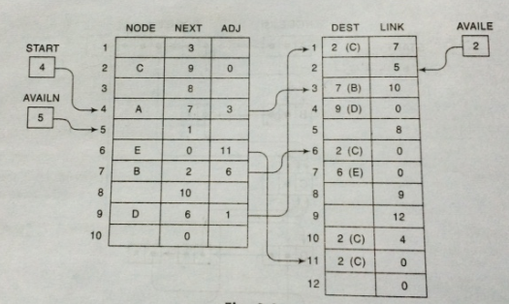
        Linked Representation of a Graph
A
D
E
B
C
Node | Adjacency List
A | B, C, D
B | C
C
D | C, E
E | C

Slide 32
Traversing a Graph
  Systematically examining the nodes and edges of a graph.
  Two methods
    Breadth First Search (BFS)
    Depth First Search (DFS)
  BFS will use Queue and DFS will use Stack as auxiliary storage
  The algorithm will process only those nodes which are reachable from the starting node
  During the execution of the algorithm, each node N of G will be in one of the three states, called status of N
    STATUS = 1 : Ready State , i.e. initial state of node N
    STATUS = 2 : Waiting State , i.e. node N is in Queue or stack waiting to be processed
    STATUS = 3 : Processed State , i.e. node N has been processed

Slide 33
Breadth-First Search:
Algorithm B: This algorithm executes a Breadth-first search on a graph G beginning at a starting node A.
Initialize all nodes to ready state , STATUS = 1
2.Put the starting node A in Queue and change its status to waiting, STATUS = 2
3.Repeat step 4 and 5 until Queue is empty
4.Remove the front node N of Queue. Process N and change STATUS of N to processed, STATUS = 3
5.Add to the rear of Queue all neighbors of N that are in ready state (STATUS = 1) and change their STATUS to waiting state ( STATUS = 2 )
6.Exit

Slide 34
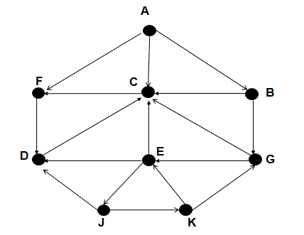
Node | Adj List
A | F, C , B
B | G, C
C | F
D | C
E | D, C, J
F | D
G | C, E
J | D, K
K | E, G
STEP | QUEUE | ORIGIN | F | R
1 | A | 0 | 1 | 1
2 | AFCB | 0AAA | 2 | 4
3 | AFCBD | 0AAAF | 3 | 5
4 | AFCBD | 0AAAF | 4 | 5
5 | AFCBDG | 0AAAFB | 5 | 6
6 | AFCBDG | 0AAAFB | 6 | 6
7 | AFCBDGE | 0AAAFBG | 7 | 7
8 | AFCBDGEJ | 0AAAFBGJ | 8 | 8
9 | … | … | .. | ..
10 | … | …. | .. | ..

Slide 35
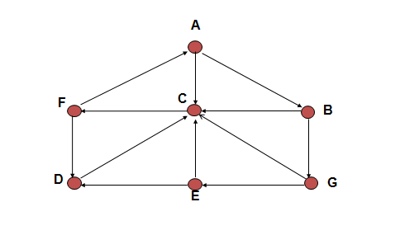
Find shortest path from A to D and from D to B using BFS.

Slide 36
Depth-First Search:
Algorithm B: This algorithm executes a depth-first search on a graph G beginning at a starting node A.
Initialize all nodes to ready state , STATUS = 1
2.Push the starting node A in STACK and change its status to waiting, STATUS = 2
3.Repeat step 4 and 5 until STACK is empty
4.Pop the TOP node N of STACK. Process N and change STATUS of N to processed, STATUS = 3
5.Push onto STACK all neighbors of N that are in ready state (STATUS = 1) and change their STATUS to waiting state ( STATUS = 2 )
[End of step 3 loop]
6. Exit

Slide 37
Node | Adj List
A | F, C , B
B | G, C
C | F
D | C
E | D, C, J
F | D
G | C, E
J | D, K
K | E, G
STEP | STACK | POP & PRINT
1 | A | A
2 | FCB | AB
3 | FCG | ABG
4 | FCE | ABGE
5 | FCDJ | ABGEJ
6 | … | …

Slide 38
Consider the given graph G, find all the nodes reachable from the node J (including J itself). [Use Depth First search]

Slide 39
Exercise to do
A
B
C
E
F
D
G
H

